Slide 1

Session 8:
Routing Protocols- Distance Vector& Link State

Slide 2
Routing Protocol
Routing protocols are the set of rules used by the routers to communicate between source & destination.
Each protocol has its own algorithm to choose the best path.
The metrics by routing protocols ,
*Number of network layer devices along with the path (hop count)
*Bandwidth
*Delay
*Load
*MTU (maximum transmission unit)
*Cost
Routing protocols store the result of these metrics in routing table.
TYPES OF ROUTING PROTOCOL
STATIC ROUTING
DYNAMIC ROUTING
1. DISTANCE VECTOR
RIP- RIPv1, RIPv2, IGRP
2.LINK STATE
OSPF, EIGRP

Slide 3
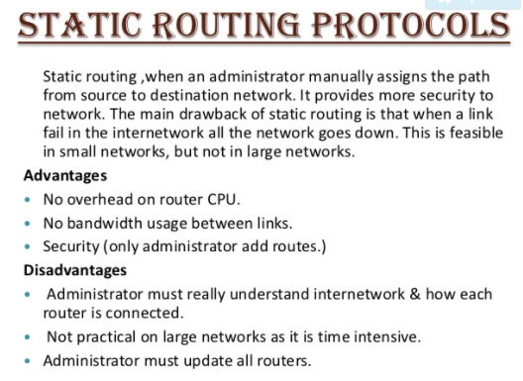
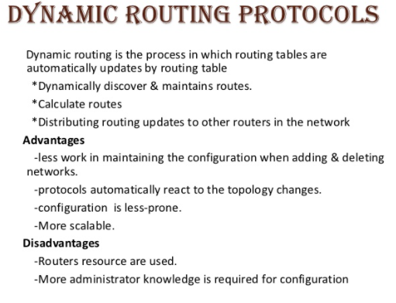

Slide 4
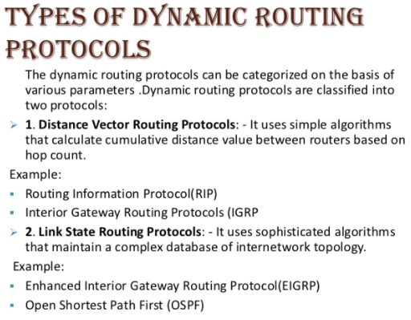
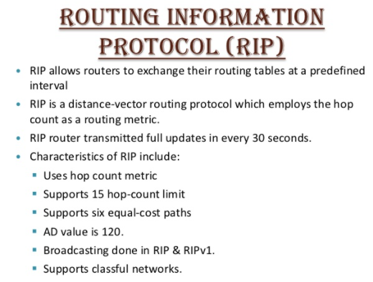
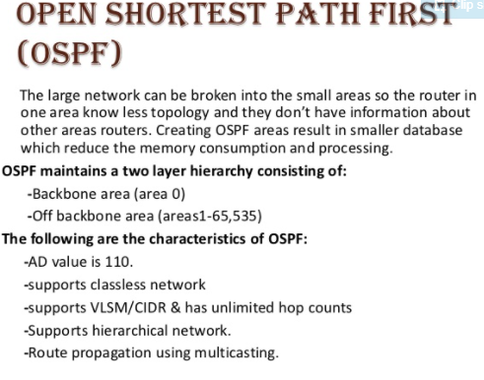

Slide 5
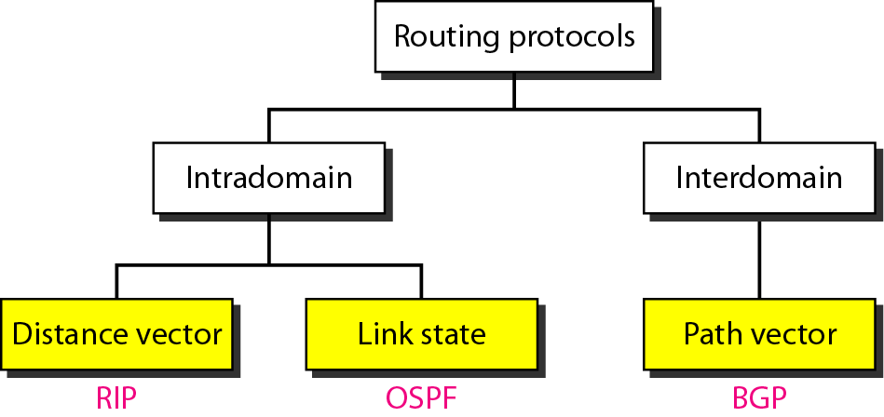
Interior and Exterior routing protocols
Each AS (autonomous system) can choose one or more intradomain(interior) routing protocol to handle routing inside the AS such as RIP and OSPF
One interdomain (exterior) routing protocol is usually chosen to handle routing between ASs ; BGP

Slide 6
Distance Vector Routing
Each node(router) maintains a set of triples (table): Destination, Cost and Next Hop
Node knows the cost to each neighbor (the distance between itself and its immediate neighbors)
Directly connected neighbors exchange updates
periodically (on the order of several seconds -30s)
whenever table changes (called triggered update)
Each update is a list of pairs: Destination, Cost
Update local table if receive a “better” route (smaller cost)

Slide 7
Updating routing table
When a node receives a two-column table from a neighbor, it needs to update its routing table.
1. The receiving node needs to add the cost between itself and the sending node to each value in the second column.
2. The receiving node needs to add the name of the sending node to each row as the third column (next hop node).
3. The receiving node needs to compare each row of its old table with the corresponding row of the modified version of the received table.
a. If the next-node entry is different, the receiving node chooses the row with the smaller cost. If there is a tie, the old one is kept.
b. If the next-node entry is the same, the receiving node chooses the new row.

Slide 8
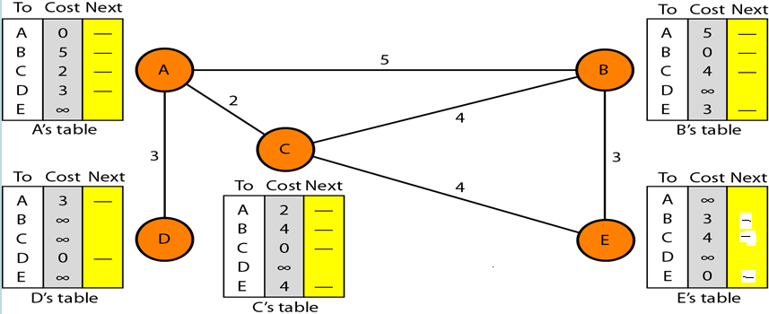
Distance vector routing
Initialization of tables in distance vector routing:
infinite ∞ ( unreachable).
Think the node as the cities and the lines as the roads connecting them

Slide 9
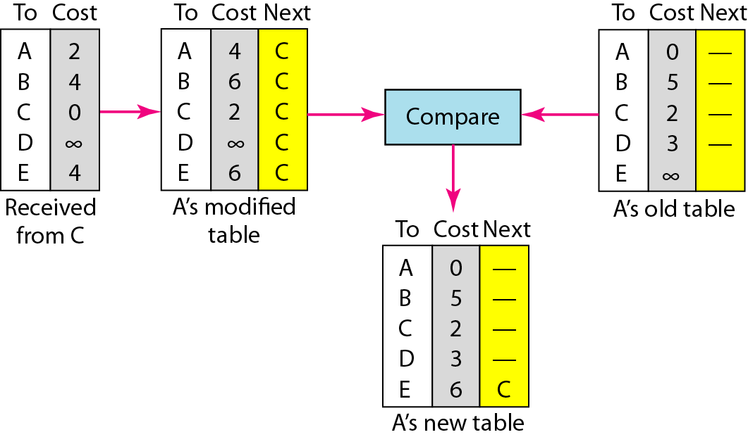
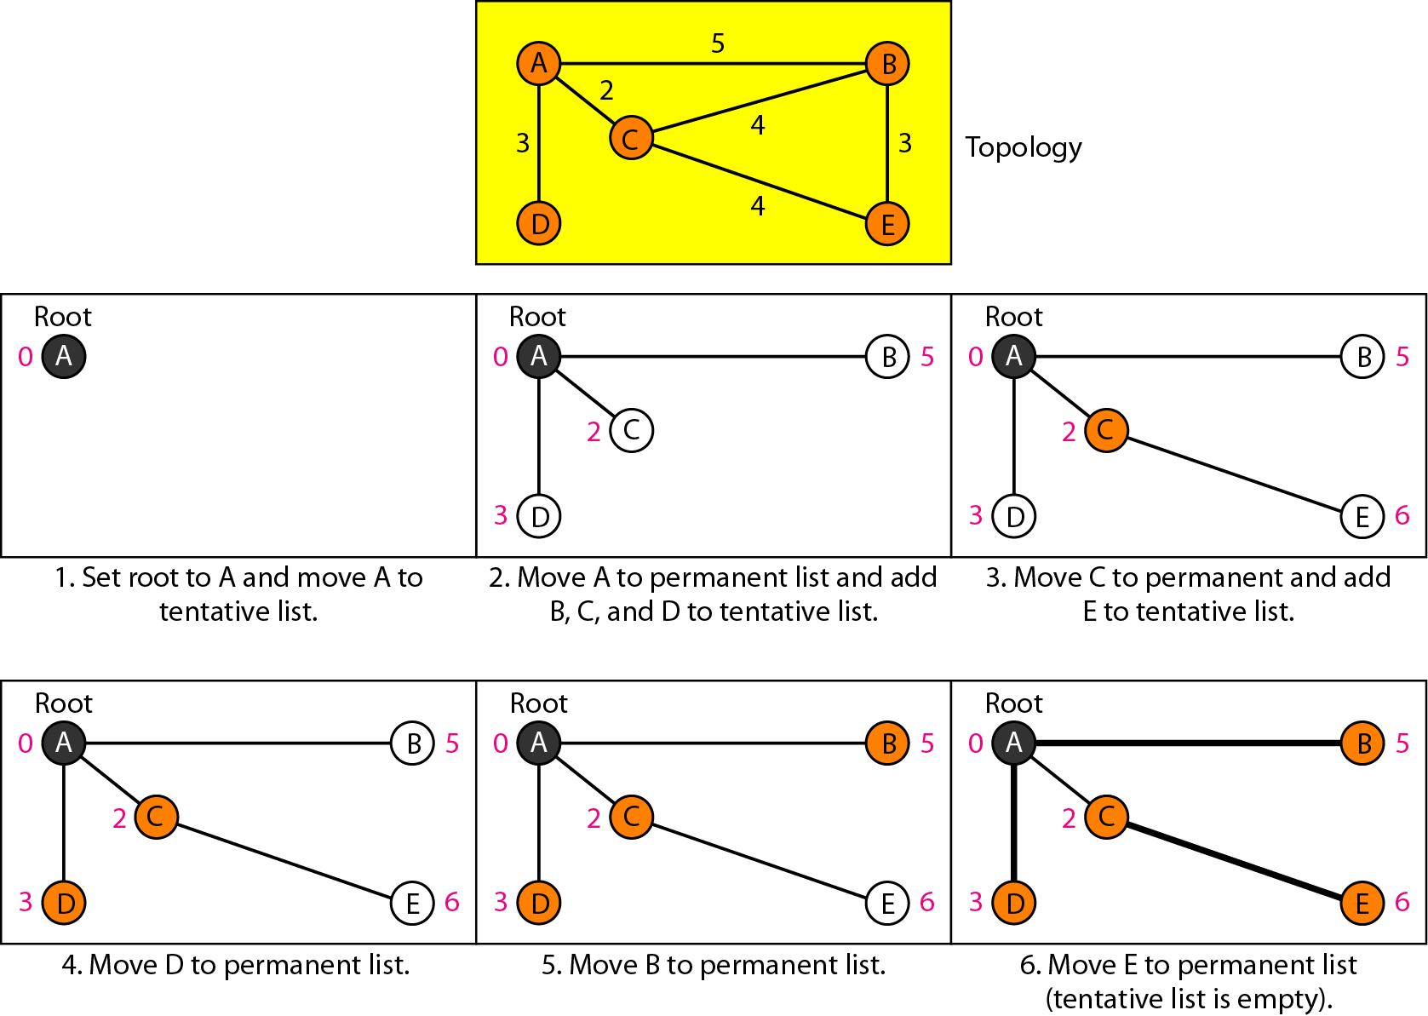
Distance vector routing
Sharing: Updating in distance vector routing

Slide 10
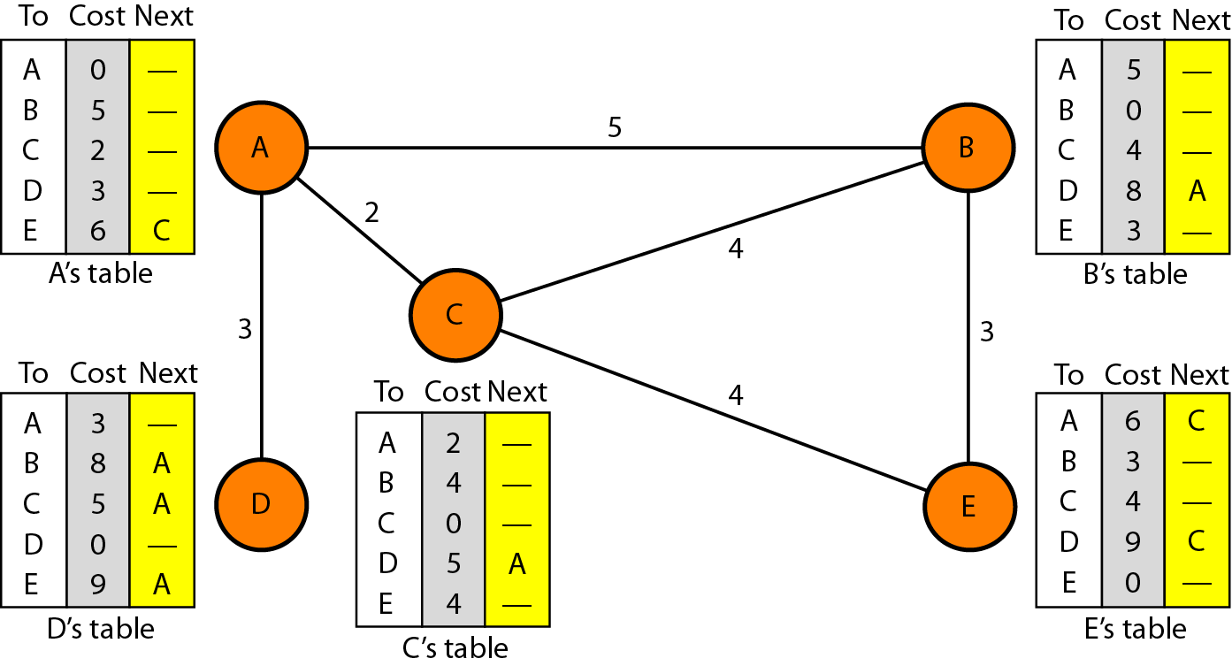
Distance vector routing
The least cost route between any two nodes is the route with min distance.
Each node maintains a table which contains : Destination, Cost, Next hop

Slide 11
Distance vector routing
Each router shares its entire routing table with its neighbours.
Sharing:
periodically update :on the order of several seconds -30s-
Triggered update: The change can result from the following:
A node receives a table from a neighbor, resulting in changes in its own table after updating.
A node detects some failure in the neighboring links which results in a distance change to infinity ∞
Each update is a list of pairs: Destination, Cost (two column routing table)

Slide 12
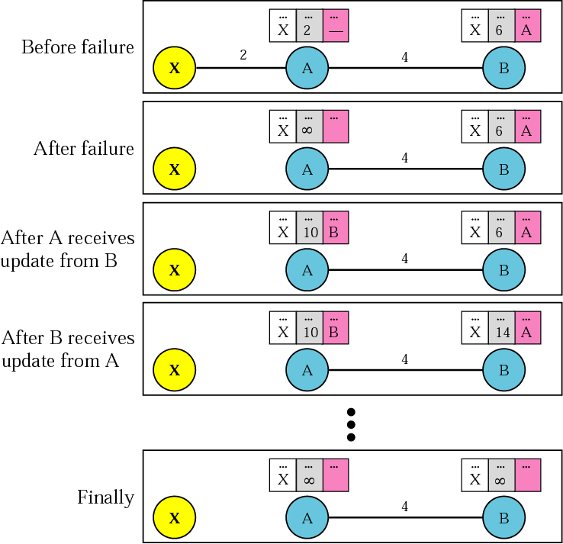
Two-Node Loop Instability
A problem with distance vector routing is instability, which means that a network using this protocol can become unstable

Slide 13
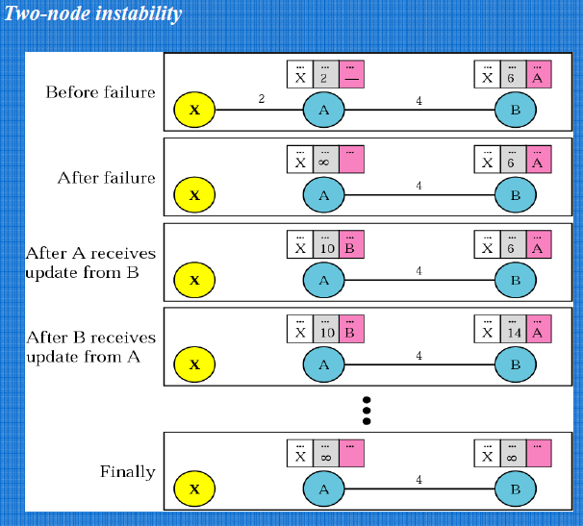

Slide 14
At the beginning, both the nodes A and B know how to reach X.
But suddenly the link between A and X fails. Node A changes its table.
If A can send its table to B immediately, everything is fine.
The system becomes unstable if B sends its routing table to A before receiving A’s routing table.
Node A receives the update from B and assumes that B has found a new route to X, then it immediately updates its table.
Based on the triggered update strategy, A sends its update to B.

Slide 15
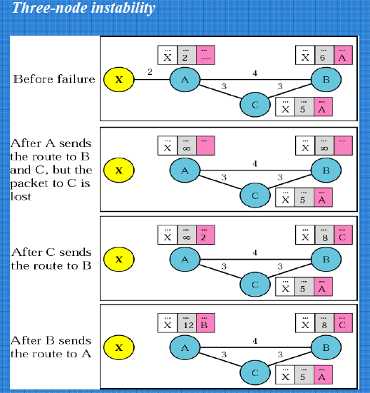

Slide 16
However , if the instability is between three nodes, stability cannot be guaranteed.
Suppose after finding that X is not reachable, node A sends packet to B and C, where packet to C is lost and it remains in the dark and still thinks that there is a route to X via A.
After a while, node C sends to B its routing table, which includes the route to X.
Now node B is fully fooled here. Now B updates its table with a cost of 8 and thinks it find a route to X via C.
Now B shares its table to node A, again this node A is fooled by updating its table with a cost of 12 and thinks it find a way to reach X via B.

Slide 17
Solutions to two-node instability
Defining Infinity. Most implementation of the distance vector protocol define the distance between each node to be 1 and define 16 as infinity. Therefore, the distance vector cannot be used in large systems
Split Horizon. In this strategy, instead of sending the table through each interface, each node sends only part of its table through each interface. If node B thinks that the optimum route to reach X is via A, it does not need to advertise this piece of information to A.

Slide 18
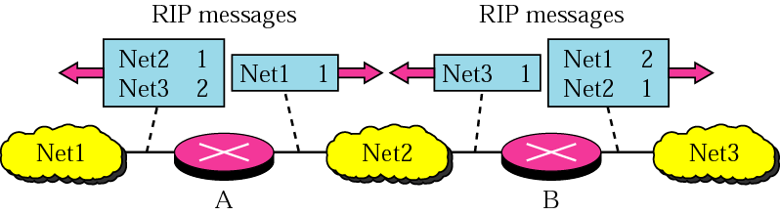
Solutions to two-node instability (cont.)

Slide 19
Solutions to two-node instability (cont.)
Split Horizon and Poison Reverse.
Normally DVR uses a timer, and if there is no news about a route, the node deletes the route from its table.
When node B eliminates the route to X from its advertisement to A, node A can’t guess that this is due to Split horizon strategy or because node B hasn’t received any news about X recently
This strategy is a combination between split horizon and poison reverse where node B can still advertise the value of X, but if the source of information is A, it can replace the distance with infinity as a warning: “Don’t use this value; what I know about this route comes from you.”

Slide 20
Review Questions
In DVR, the periodic update of the routing table normally occurs every _______.
In distance vector routing, each node shares its routing table with its ______ periodically.
Distance vector routing algorithm is implemented in Internet as _______.

Slide 21
Answers
30 Seconds
Immediate neighbours
RIP

Slide 22
LSR (Link State Routing)
It has different philosophy from that of DVR.
Each node in the domain has the entire topology of the domain – list of nodes and links, how they are connected including the type, cost(metric), and conditions of the links.
Node uses Dijkstra’s algorithm to build a routing table.
LSR is based on the assumption that, although the global knowledge about the topology is not clear, each node has partial knowledge.
It knows the state(type, condition and cost) of its link.
In other words the whole topology can be obtained from the partial knowledge of each node.

Slide 23
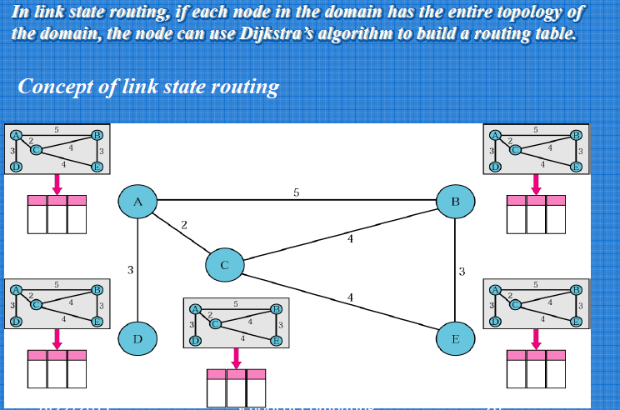

Slide 24
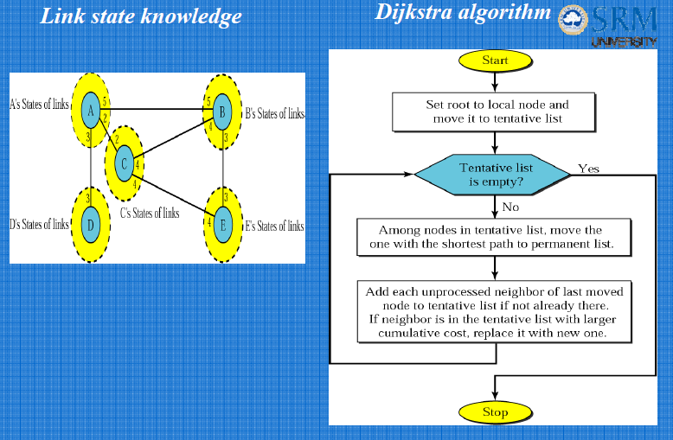

Slide 25
Building the routing table:
Four set of actions are required to ensure that each node has the routing table showing the least cost node to every node.
Creation of LSP
Dissemination of LSP – Flooding
Formation of a shortest path tree for each node
Calculation of a routing table based on the shortest path tree.

Slide 26
Creation of LSP:
A LSP can carry a large amount of information.
It carries Node identity, list of links – needed to make the topology
A sequence number – facilitates flooding and distinguishes new LSP’s from the old LSP’s
An age – prevents the old LSP’s from remaining in the domain for the longer time.
LSP’s are generated on 2 occasion:
1. when there is a change in the topology of the domain – Triggering
2. on a periodic basis: Ranges from 1 to 2 minutes

Slide 27
Flooding:
After a node has prepared the LSP, it must be disseminated to all other nodes , not only to its neighbours.
It is based on the following:
1. The creating node sends a copy of the LSP out of each interface.
2. A node that receives the LSP compares it with the copy. If the newly arrived LSP is older than the one it has found (by checking the sequence number), it discards the LSP. (Controlled flooding)
If it is newer one then the node does the following:
1. Discards the old LSP and keep the new LSP
2. sends a copy of it out of each interface except the one from which the packet arrived. (Controlled flooding)

Slide 28
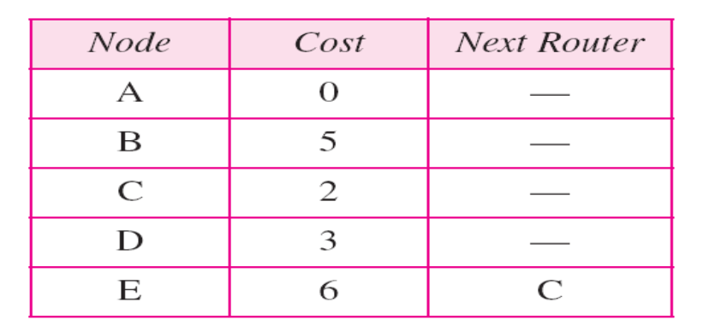
Make node A –root of the tree and move it to the tentative list.
Permanent list : Empty Tentative list: A(0)
Node A – shortest cumulative cost from all nodes in the tentative list. Add all neighbours of A to the tentative list.
Permanent list : A(0) Tentative list: B(5), C(2), D(3)
Node C – shortest cumulative cost from all nodes in the tentative list. Node C has 3 neighbours, but node A is already processed, which makes the unprocessed neighbours B and E. Node B is already in tentative list with a cumulative cost of 5.
Node A can also reach Node B through node C with a cost of 6. Since 5 < 6, keep the node B with a cost of 5in the T. L. And do not replace it.
Permanent list : A(0), C(2) Tentative list: B(5),D(3),E(6)
Keep on doing so we can formulate the shortest path tree and once we find it , the routing table for A to reach all other nodes by shortest path can be calculated.

